Slide 1
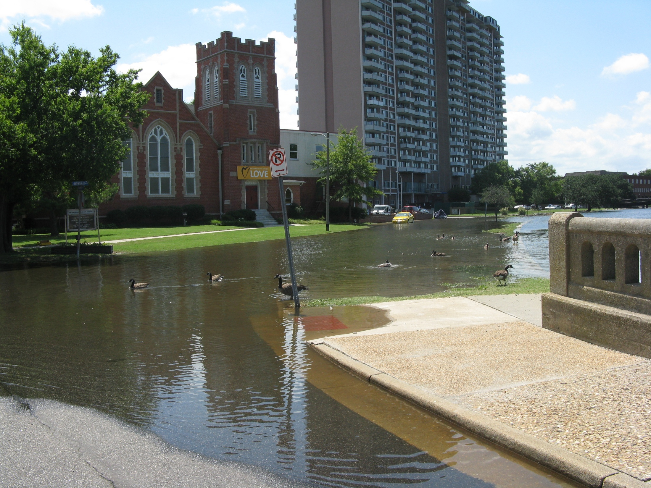

Regional Planning for Sea-Level Rise in Hampton Roads
NOAA Hydrographic Services Review Panel
October 26, 2011
Benjamin McFarlane, AICP
Regional Planner

Slide 2
What is the HRPDC?
2
1 of 21 Regional Planning Agencies
State enabled; locally created
16 Cities & Counties; several Towns; 1.7 million people; 3,000 square miles; 5,000 miles shoreline
Commission – 45 local elected officials & CAO
Staff – Executive Director & 45 staff
Funding – Local contributions, grants, and contracts
Functions – Economics, Housing, Transportation, Environmental, Emergency Management
Budget $12,000,000 +
Role – Policy & Technical Analysis, Planning & Engineering Studies, Cooperative Problem Solving, Coordination

Slide 3
What does HRPDC do?
3
The Commission:
  “serves as a forum for local and elected officials and chief administrators to deliberate and decide issues of regional importance”
The Staff:
  “provides the local governments and citizens of Hampton Roads credible and timely planning, research, and analysis on matters of mutual concern, and”
  “provides leadership and offers strategies and support services to other public and private, local, and regional agencies, in their efforts to improve the region’s quality of life.”

Slide 4
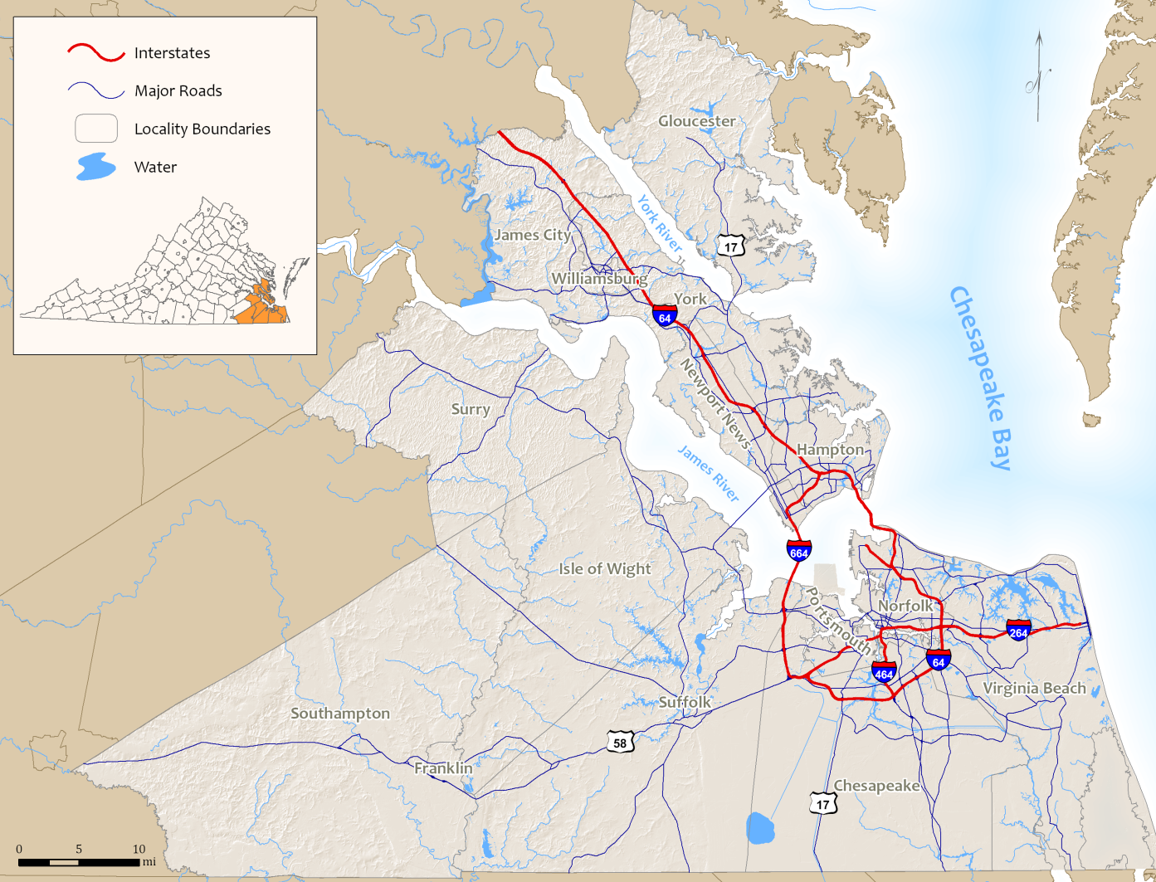

Slide 5
HRPDC and NOAA
5
Coastal resources management is a major emphasis of the HRPDC’s planning efforts
HRPDC coordinates regional emergency management planning and hazard mitigation planning
HRPDC is a partner in the Virginia Coastal Zone Management Program (VCZMP) and receives funding on an annual basis
  Technical Assistance Grants
  Focal Area Grants

Slide 6
Hazard Mitigation Planning
6
Two regional efforts
  Peninsula
  Southside
This process seeks to better prepare the region when hazards occur
High quality and accurate data is essential to effectively identify, analyze, and reduce risks
  Floodplain management
  Hurricane evacuation

Slide 7
Technical Assistance
7
Environmental impact review
Local and regional coordination of environmental programs
Data analysis and research on specific issues
  GIS

Slide 8
Focal Area Grants
8
Focal Areas are designated by the Commonwealth on a multi-year schedule and are designed to address specific issues
For FY08-09 to FY10-11, VCZMP selected Climate Change Adaptation as one of two focal areas for grants to PDCs
  Hampton Roads, Middle Peninsula, Northern Virginia

Slide 9
HRPDC Climate Change Initiative
9
Year 1: Begin stakeholder process and identify broad impacts of climate change on Hampton Roads
Year 2: Assessment of impacts and development of policy recommendations
Year 3: Analysis of infrastructure and economic impacts and completion of the regional framework for mitigation and adaptation to climate change

Slide 10
HRPDC Climate Change Initiative
10
Three parts:
  Coordination
  Outreach
  Research and Analysis

Slide 11
Coordination
11
Working with other organizations and institutions to promote awareness of sea level rise and flooding issues in Hampton Roads
ODU Initiative
UVA-CRMES: Vulnerability of transportation infrastructure
ODU: Economic impacts of flooding and sea level rise
Storm Surge modeling with VIMS

Slide 12
Outreach
12
Engaging local governments, citizens, and stakeholders through public meetings
UVA-IEN/Wetlands Watch: Listening sessions in Virginia Beach
Other public meetings to city councils and citizen groups

Slide 13
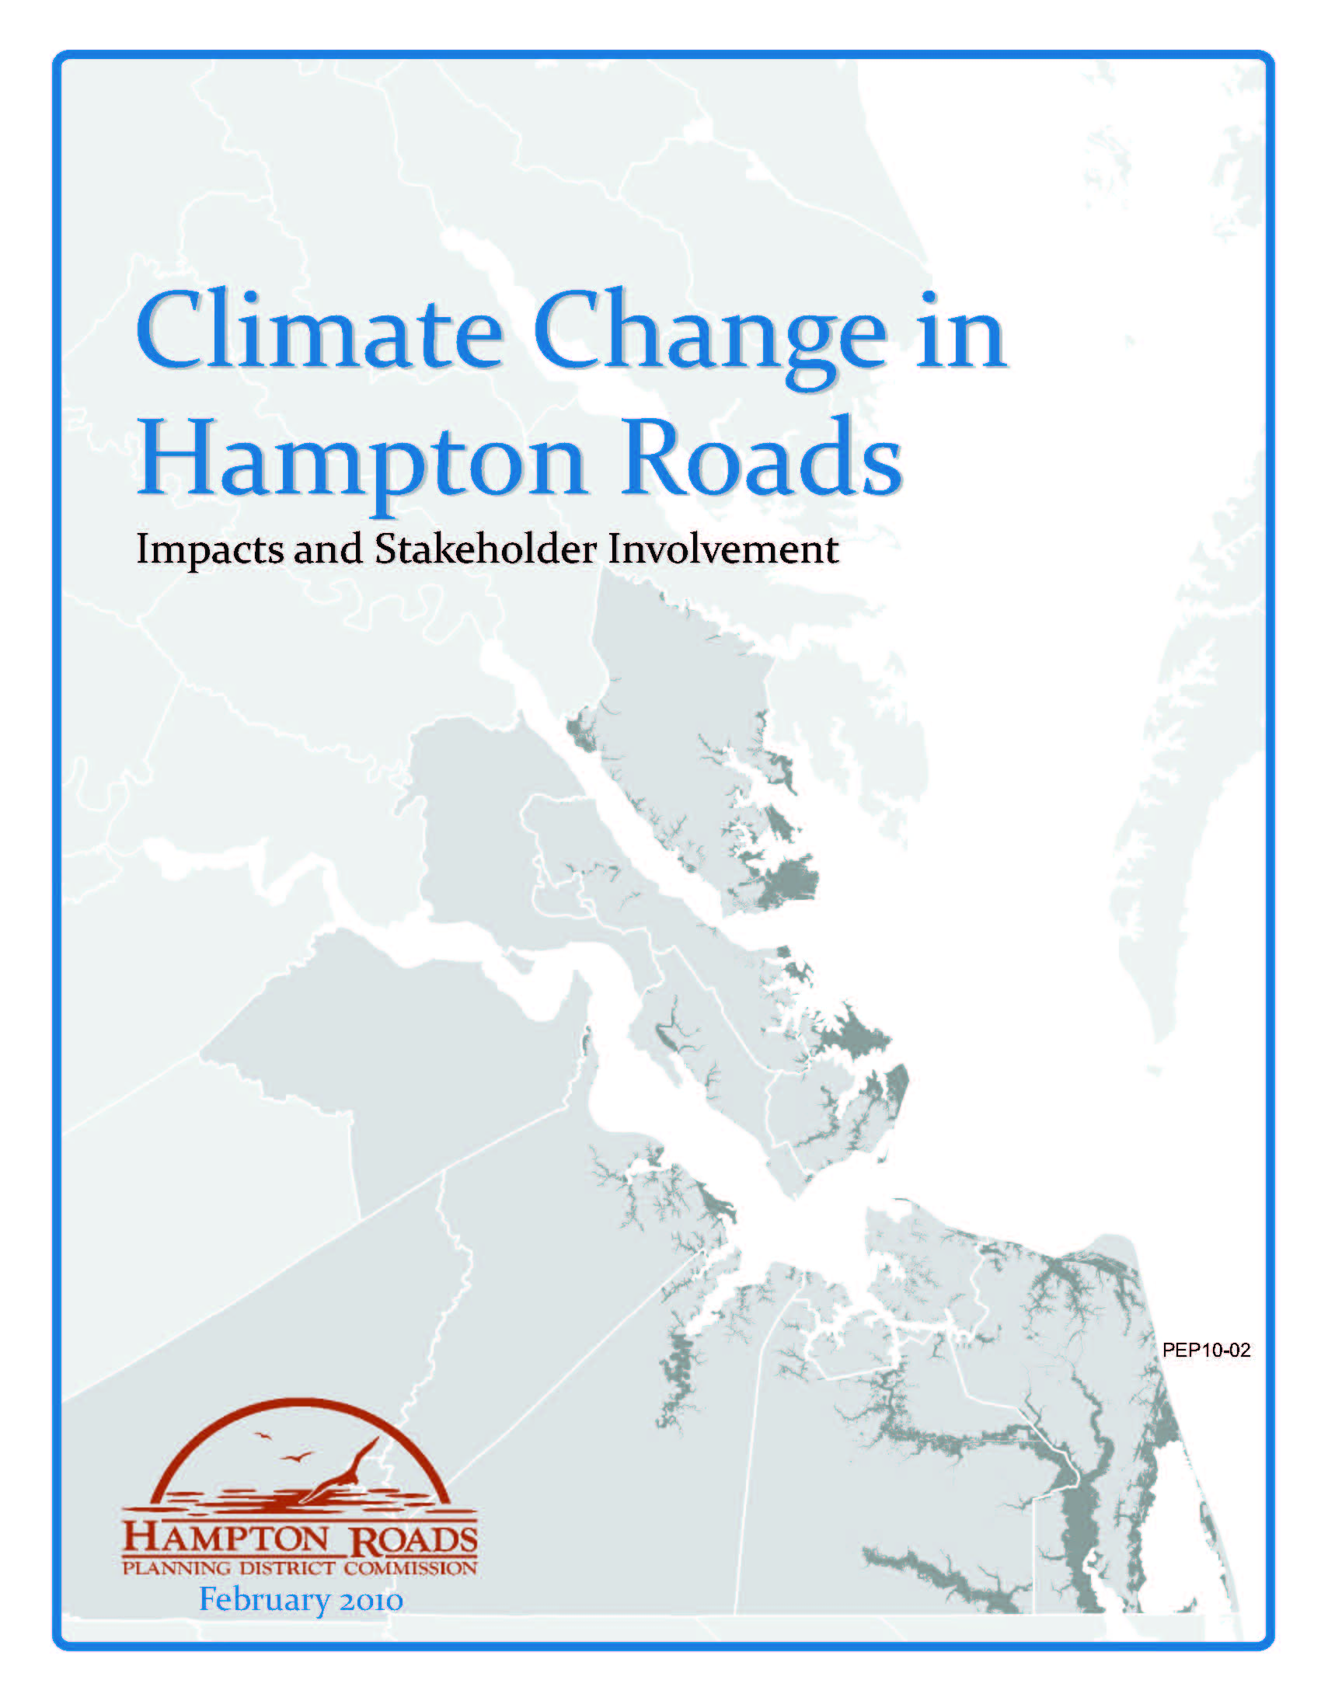
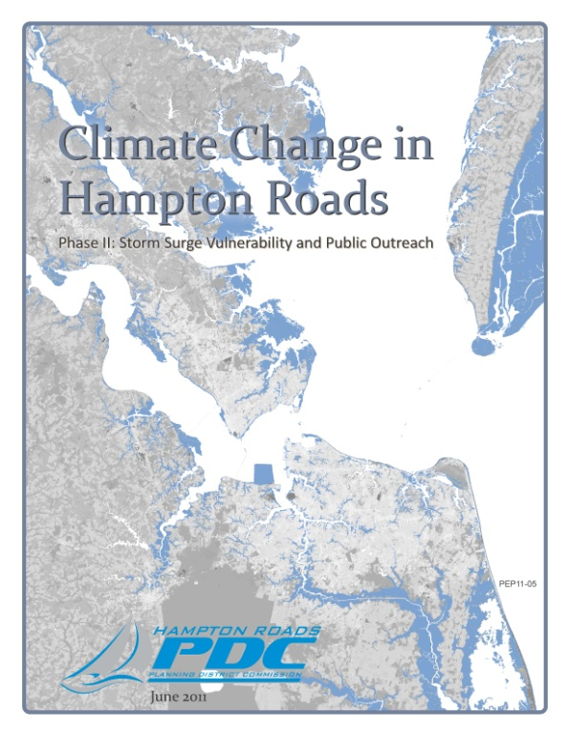
Research and Analysis
13
Year 1: Natural Resources focus
Year 2: Storm Surge Exposure

Slide 14
Data and Methodology
14
Developed based on case study research and available data
Use asset datasets from several sources with storm surge areas to estimate regional and local vulnerability to hurricane storm surge flooding and sea level rise
Use geographic information systems (GIS) analysis to show which assets are in vulnerable areas and sum the results by locality and storm surge category
Notes:
14

Slide 15
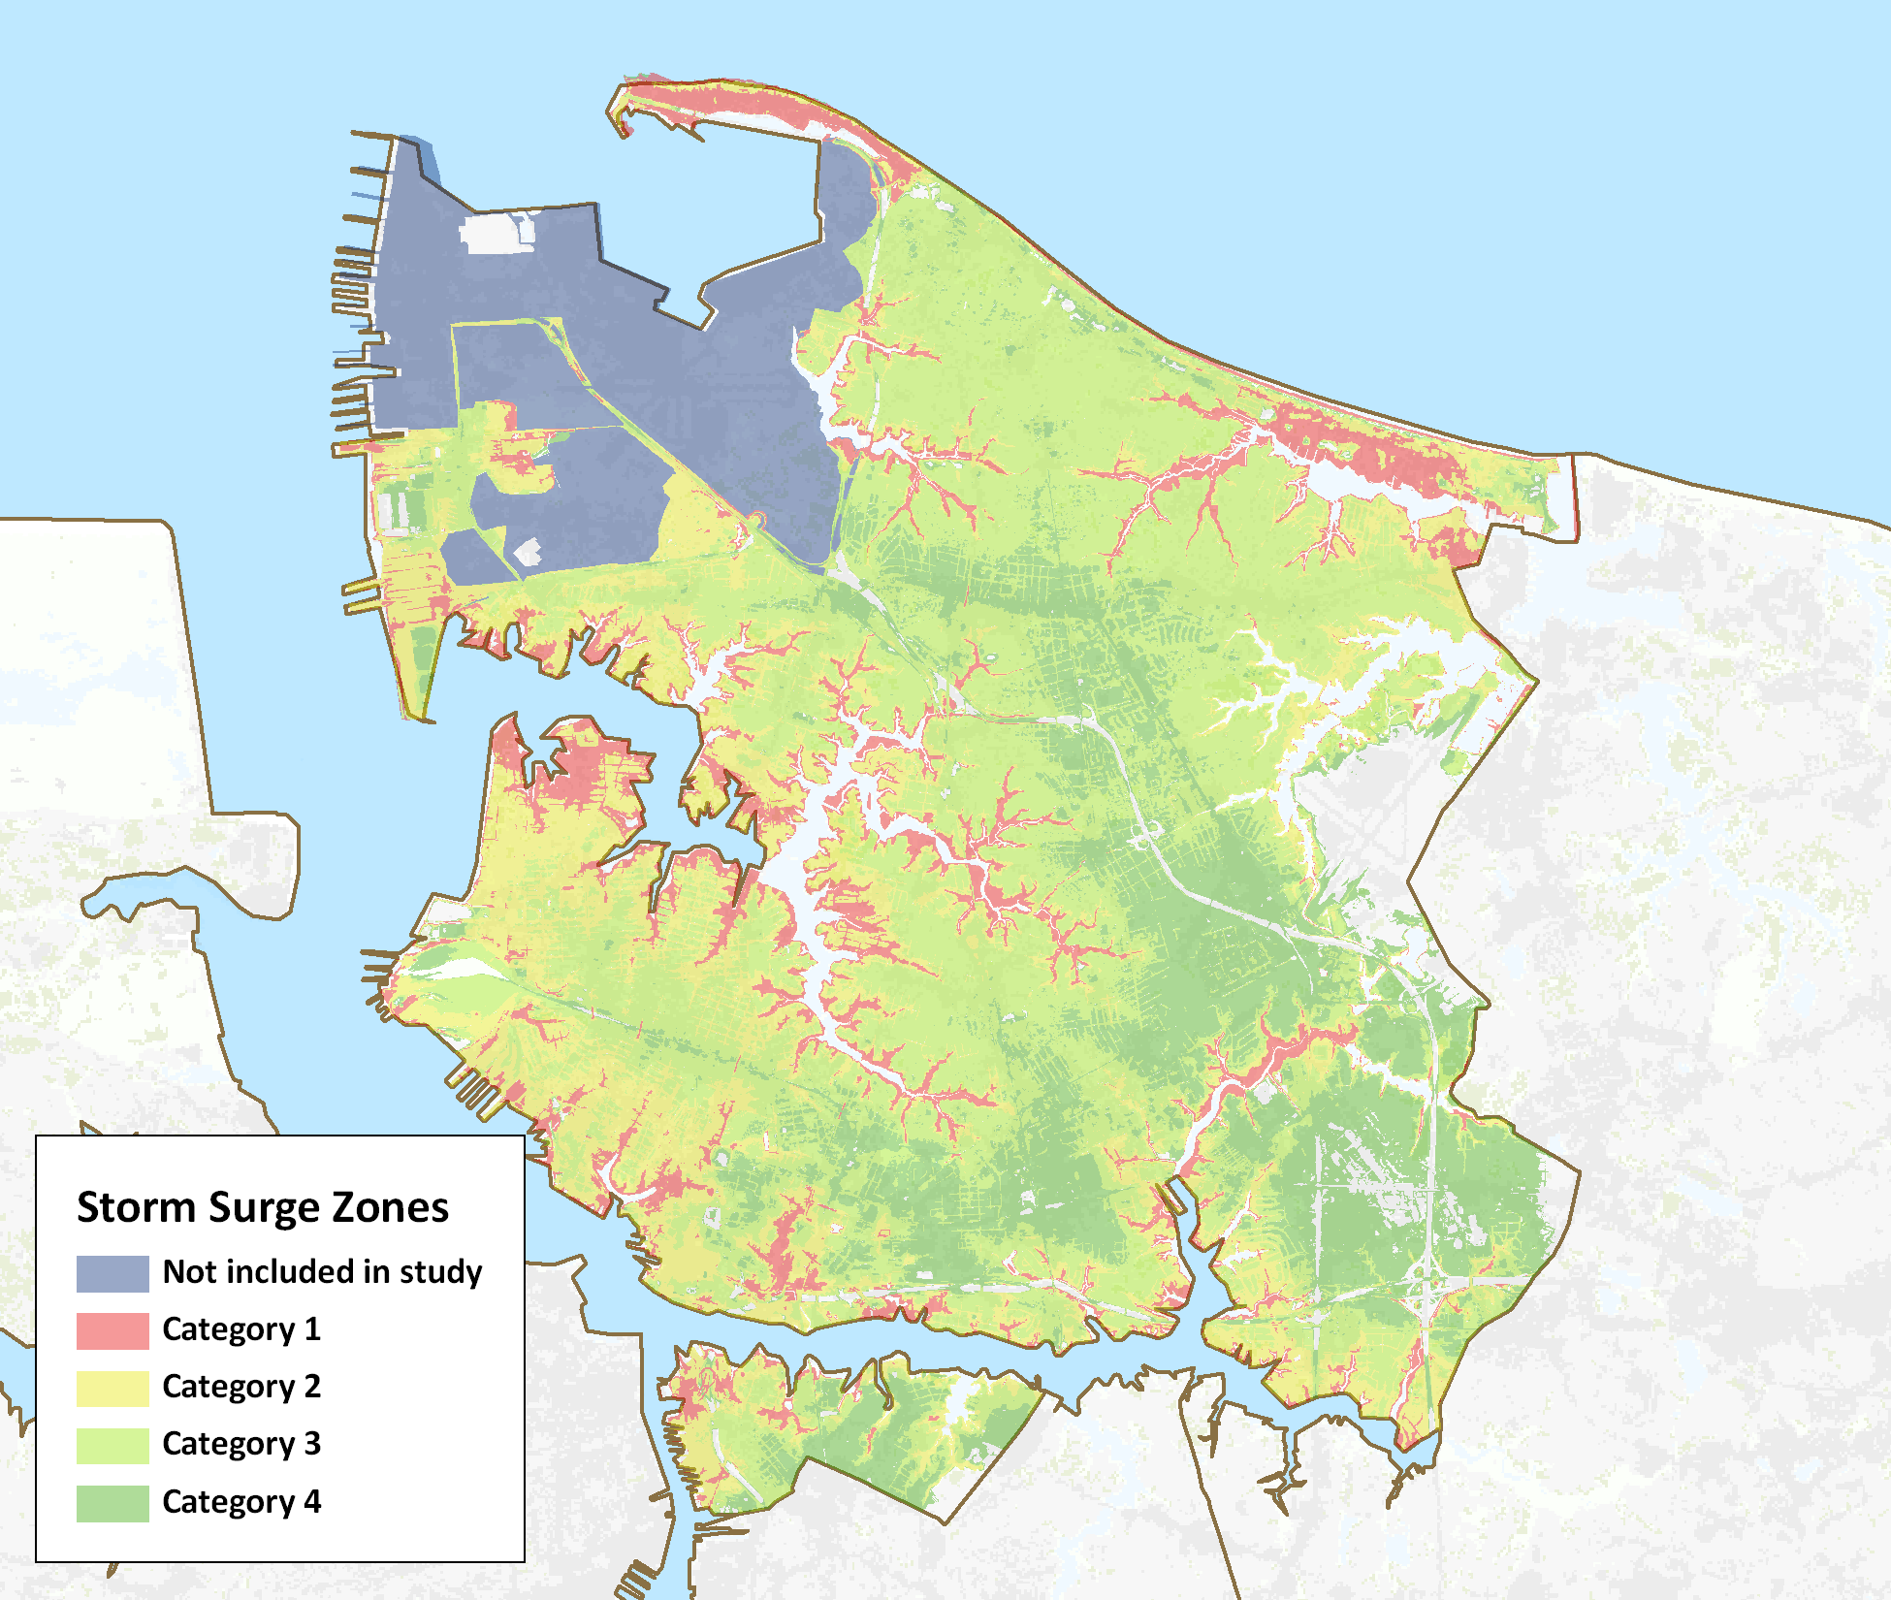
Results – Norfolk (example)
15
Local results are included for each of the twelve Hampton Roads localities included in the 2008 Virginia Hurricane Evacuation Study
Norfolk, Virginia Storm Surge Inundation Areas
Notes:
15

Slide 16
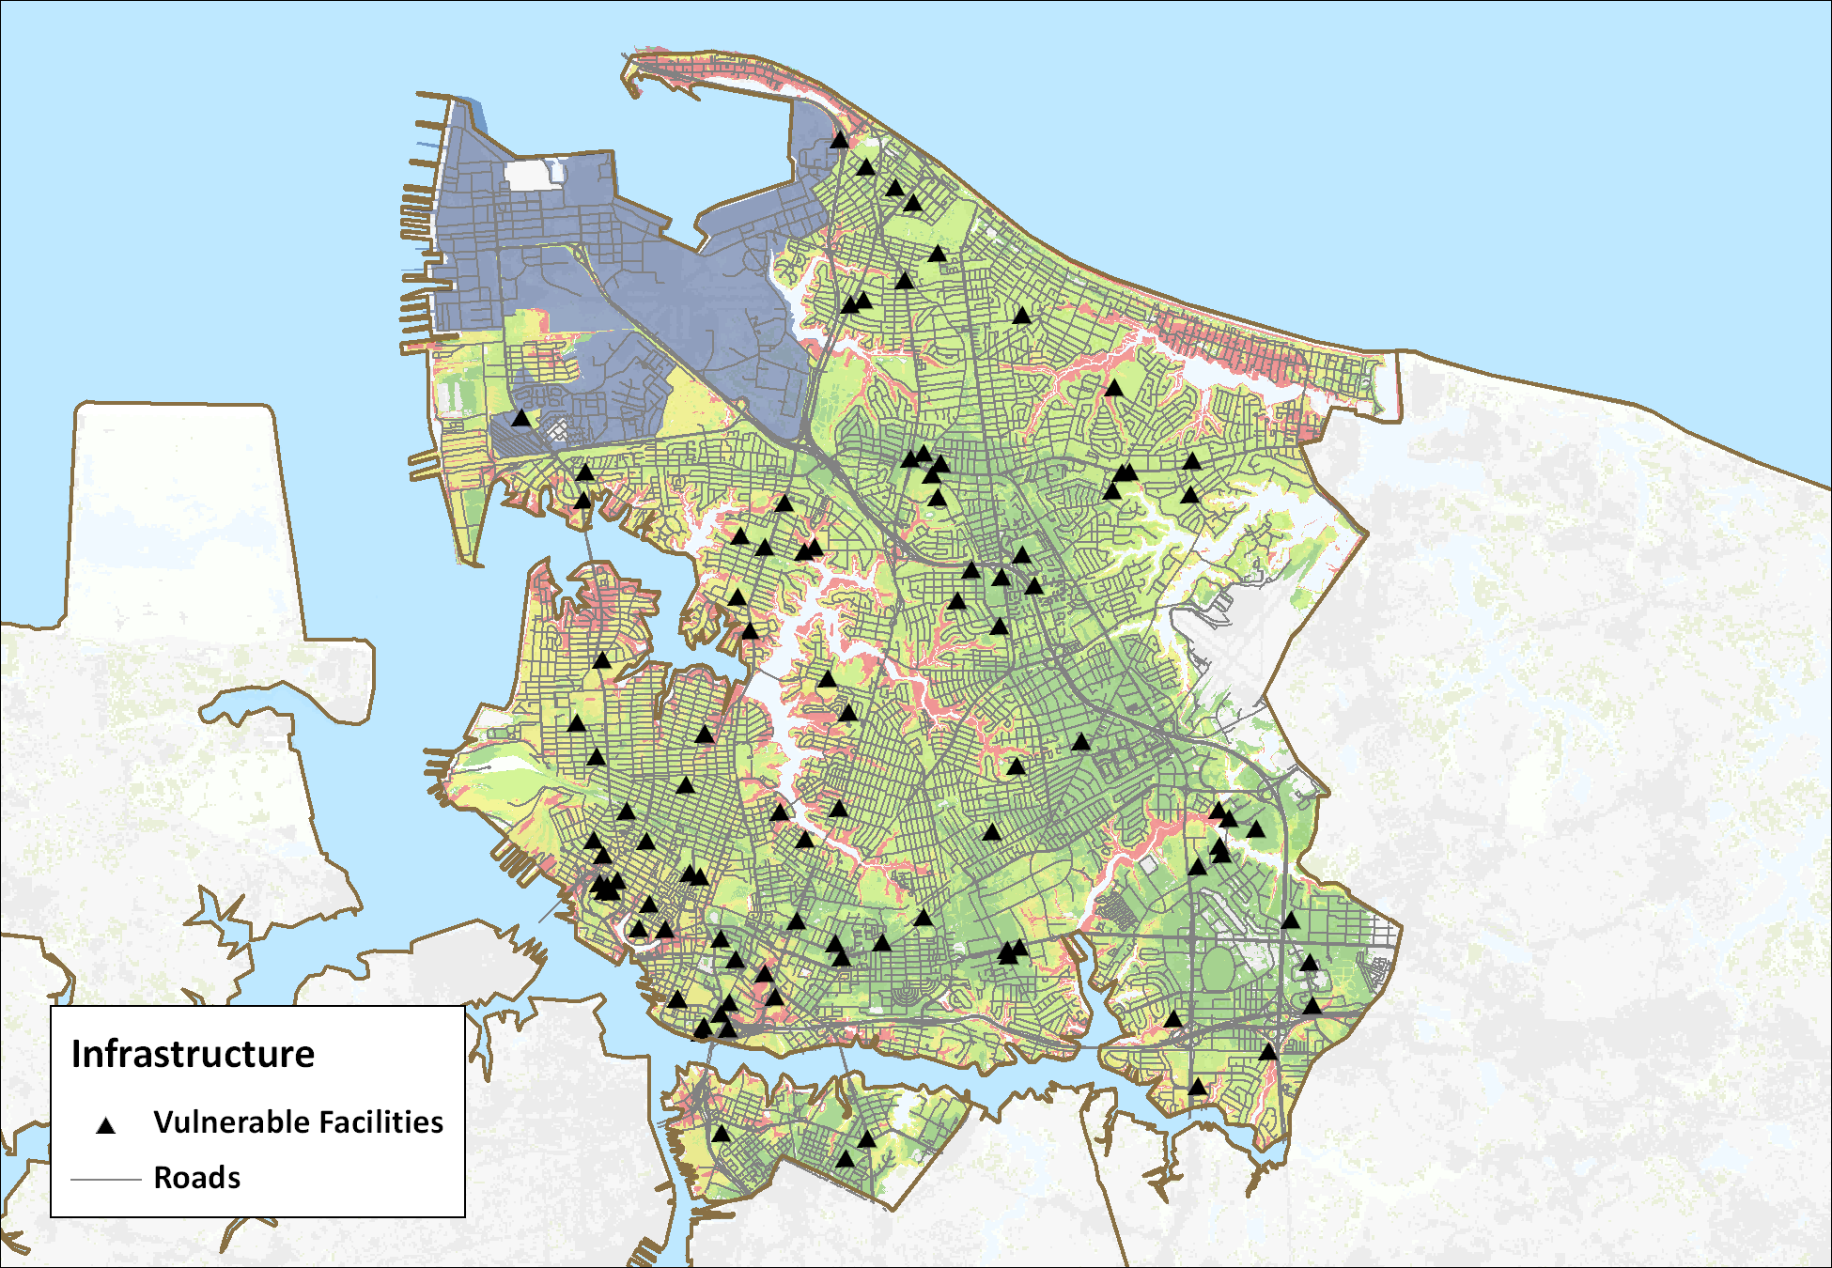
Results – Norfolk (example)
16
Roads and Critical Infrastructure Vulnerable to Storm Surge in Norfolk, Virginia
Notes:
16

Slide 17
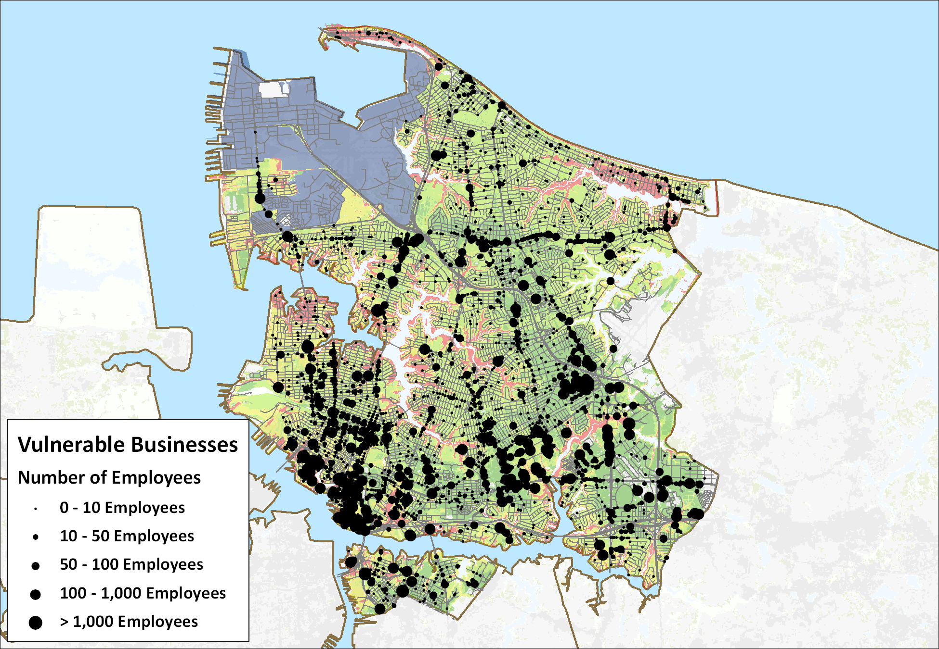
Results – Norfolk (example)
17
Businesses Vulnerable to Storm Surge
in Norfolk, Virginia
Notes:
17

Slide 18
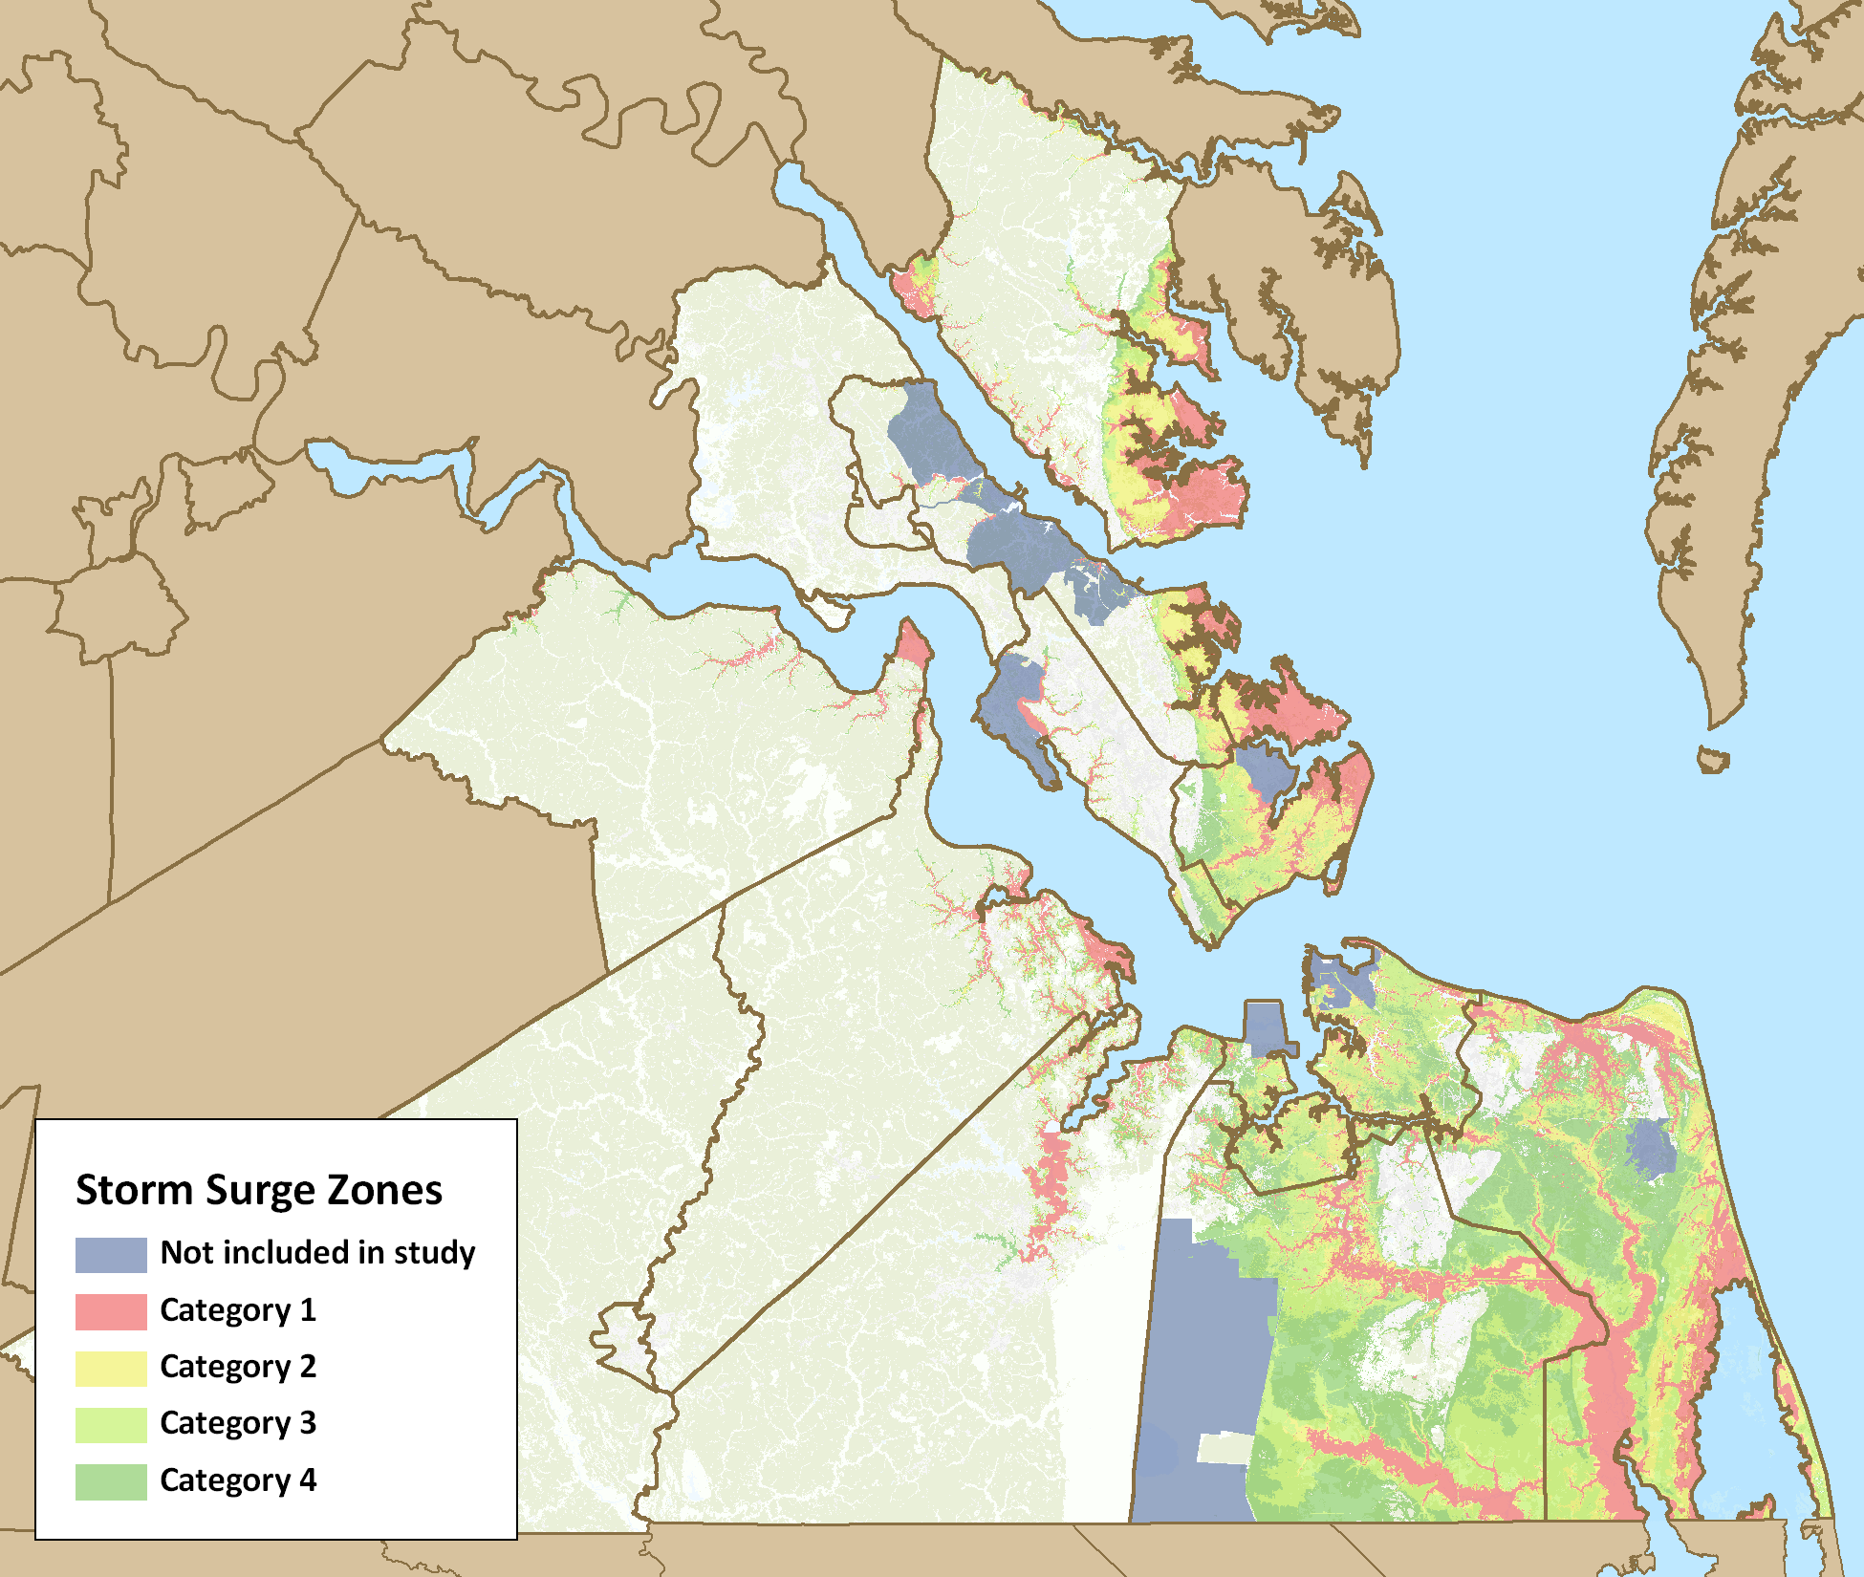
Results – Region
18
Overall, high level of exposure to storm surge across the region
Southside is more vulnerable to larger events than the Peninsula
Significant population, infrastructure, critical facilities, and businesses at risk
Hampton Roads, Virginia Storm Surge Inundation Areas
Notes:
18

Slide 19
Conclusions
19
Hampton Roads is significantly vulnerable to storm surge and sea level rise
Baseline assumption of sea level rise equal to historical trend is appropriate
Acceleration of sea level rise will depend on many factors, so it should be monitored and planning assumptions updated as needed
New data should be incorporated as available
Notes:
19

Slide 20
HRPDC and NOAA
20
HRPDC and the region rely on NOAA’s data and services
  NGS provides accurate reference information, which provides a foundation for all our geographic analysis
  CO-OPS provides tidal data and predictions and sea level trends
  HRPDC also utilizes resources from the Coastal Services Center

Slide 21
HRPDC and NOAA
21
Data from Tides and Currents are a major part of research and analysis of sea level rise in Hampton Roads
Accurate data on trends of sea-level rise are an essential part of adaptation planning
  The historical record helps gain public support for planning
  Past trends are used in modeling future change
  Continuous observations and predictions of tides add to the existing record while also providing needed services to the region

Slide 22
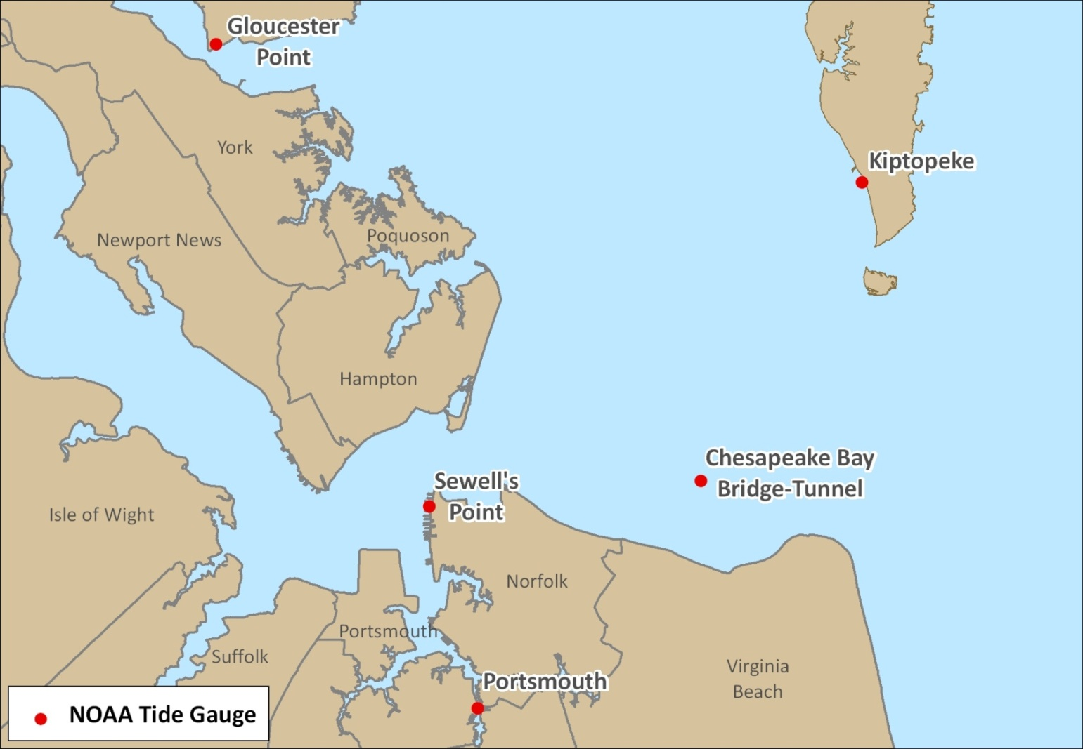
NOAA Tide Stations
22
0.14±0.02 inches/year
(1.14 ft/100 yrs)
0.15±0.02 inches/year
(1.25 ft/100 yrs)
0.24±0.04 inches/year
(1.98 ft/100 yrs)
0.17±0.01 inches/year
(1.46 ft/100 yrs)
0.15±0.02 inches/year
(1.23 ft/100 yrs)

Slide 23
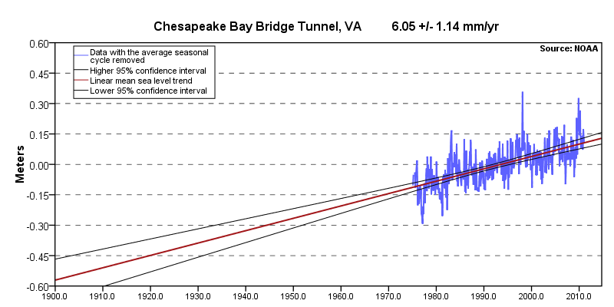
Chesapeake Bay Bridge-Tunnel
23

Slide 24
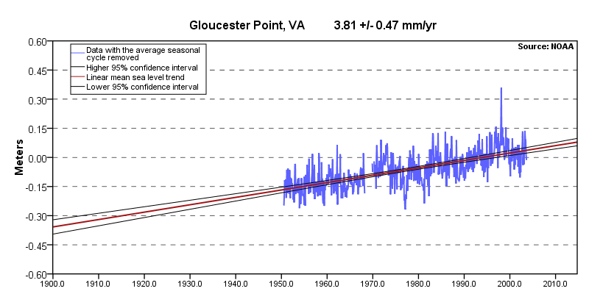
Gloucester County, VA
24

Slide 25
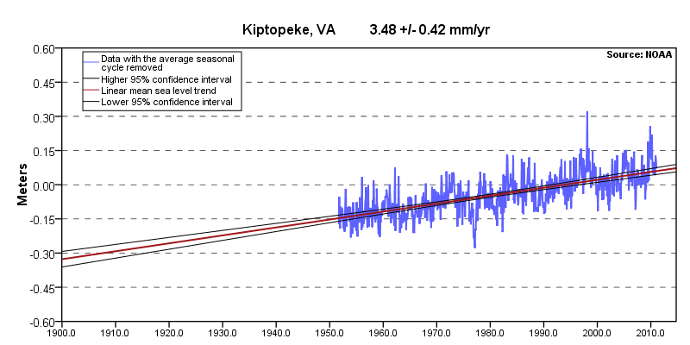
Kiptopeke, VA
25

Slide 26
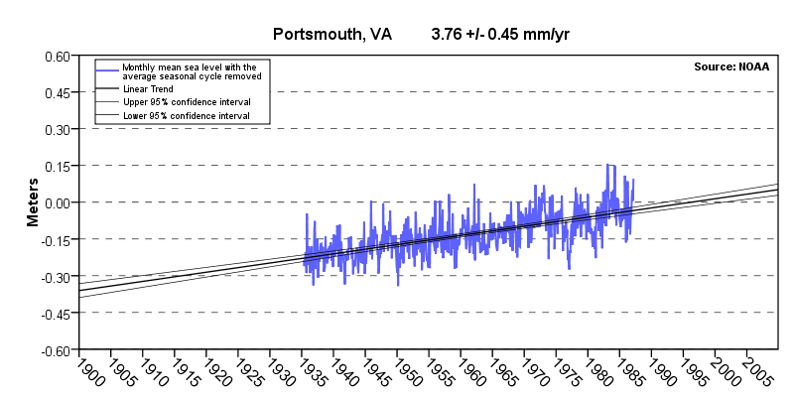
Portsmouth, VA
26

Slide 27
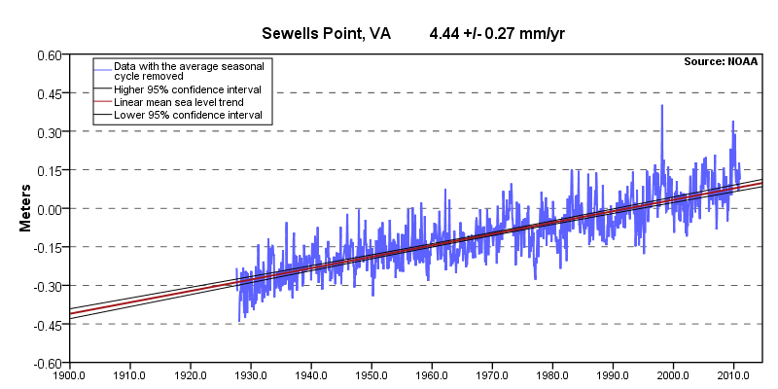
Sewell’s Point, VA
27

Slide 28
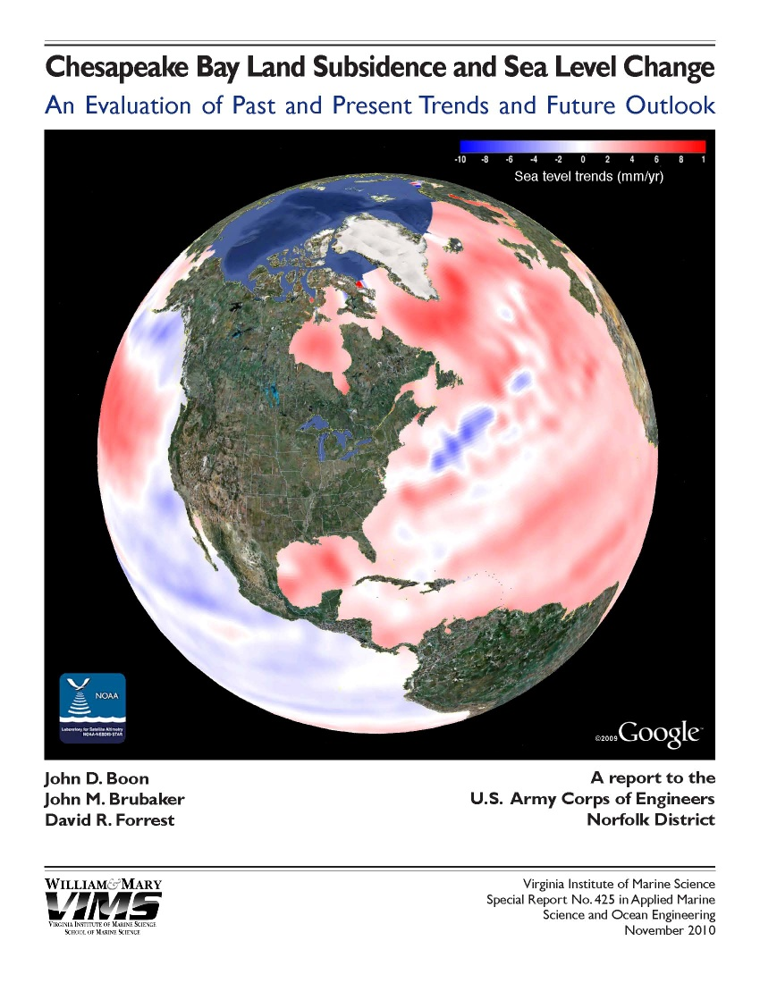
HRPDC and NOAA
28
In Hampton Roads, absolute sea level rise rates seem to be lower than average, but “local subsidence more than makes up for it.”
Tides and Currents data help separate local and global causes of sea level rise
Notes:
28

Slide 29
HRPDC and NOAA
29
Continuation and enhancement of Tides and Currents is essential for the Hampton Roads region in planning for sea level rise
Integration and cooperation with other federal agencies to develop complementary datasets and services
  USGS, FEMA
Standards for shoreline mapping are needed
  Sea level benchmarks
  LIDAR minimum standards

Slide 30
30
Benjamin J. McFarlane, AICP
Regional Planner
Hampton Roads Planning District Commission
bmcfarlane@hrpdcva.gov

